Slide 1

Take Home Test 2
By
Ben Variano
CSC 342/343
Professor Gertner
Fall 2019

Slide 2
Objective
To understand the recursive function call and how it allocates and interacts with memory
We examine recursive calls through the execution and debugging of a recursive GCD file which implements the Euclidean algorithm
We will be doing so using Microsoft Visual Studio, Mars MIPs, 32-bit Raspbian Linux distribution and a 64-bit Linux distribution

Slide 3
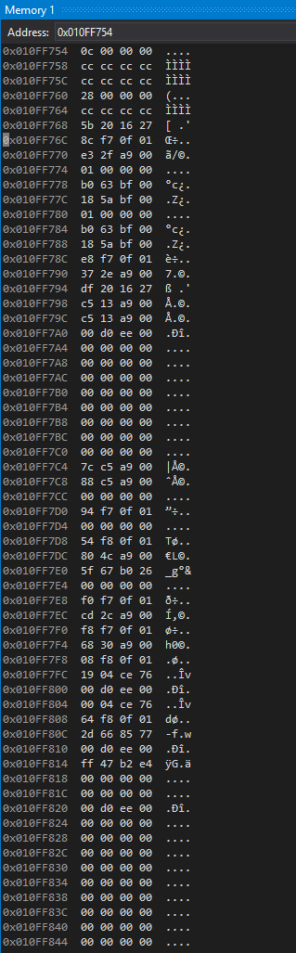
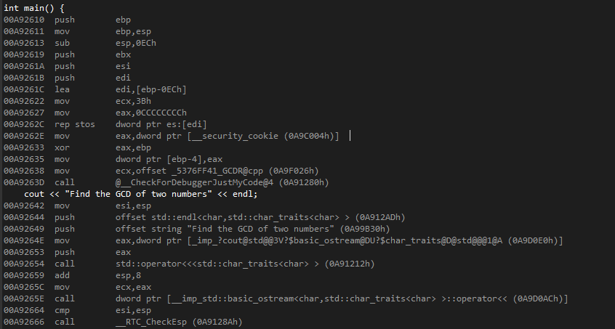
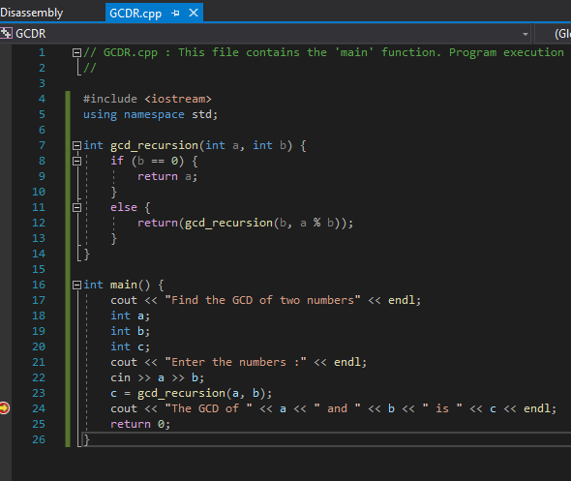
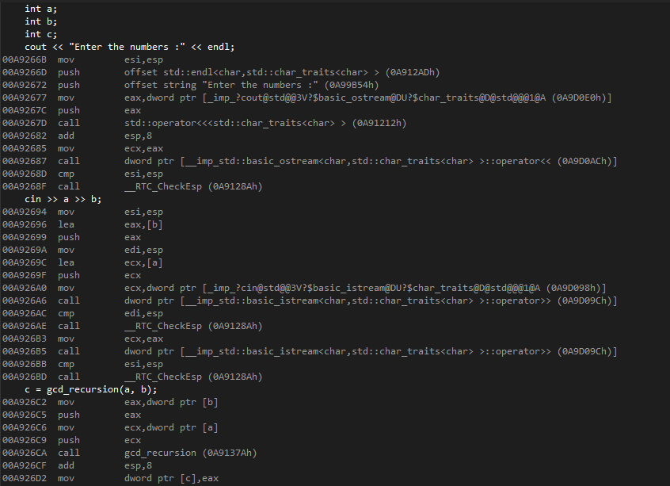
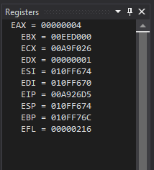
Visual Studio
EBP of main
Return Address
argument
Instruction pointer
Stack pointer
Base Pointer

Slide 4
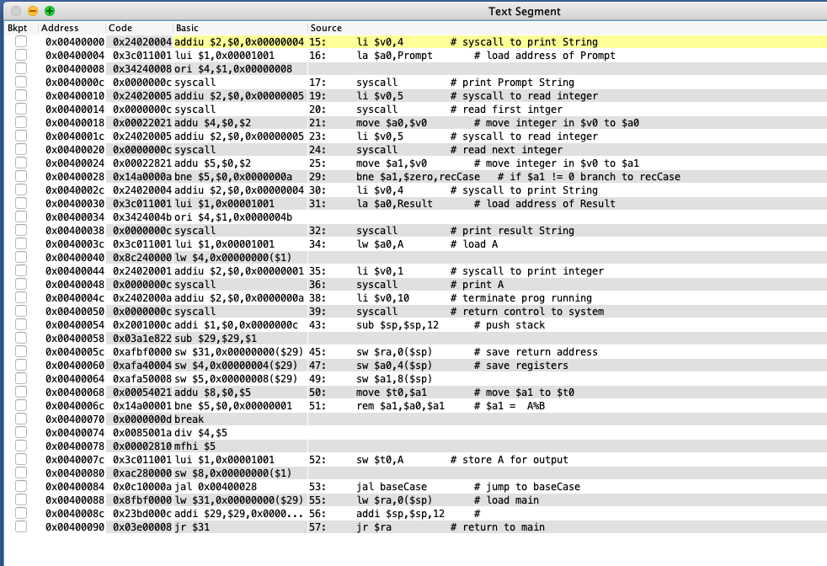
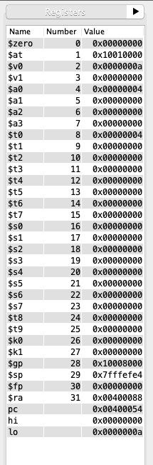
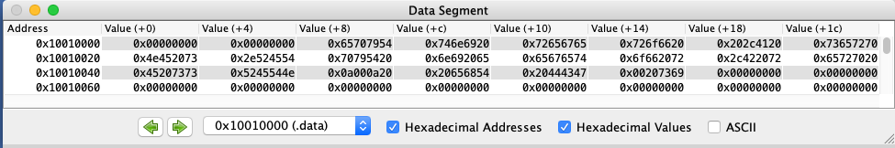
Mars MIPs

Slide 5
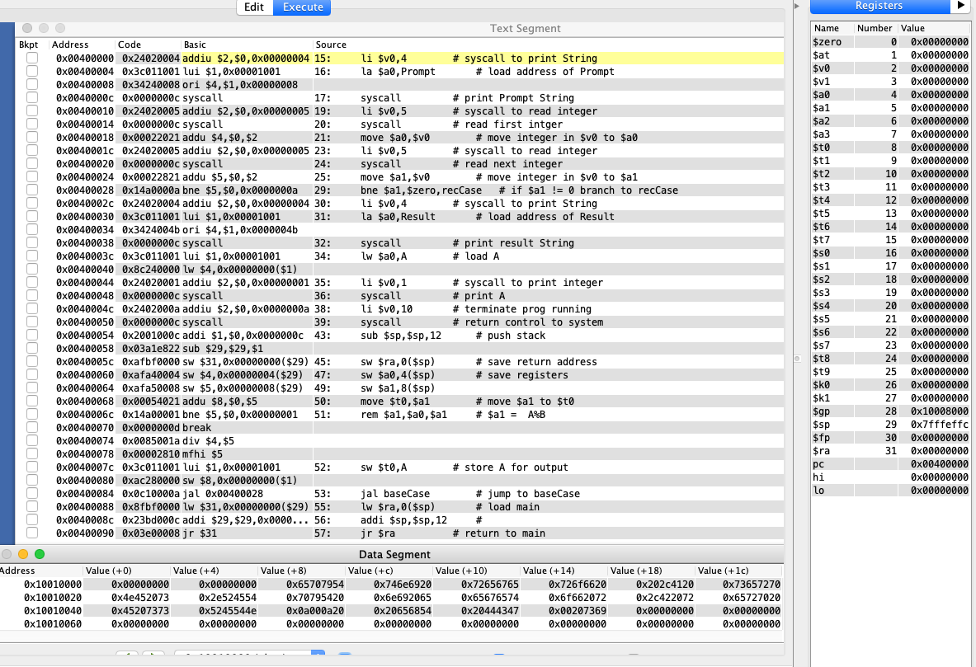
Global Base Pointer
Stack Pointer
Return Address
Program Counter
Argument at current level

Slide 6
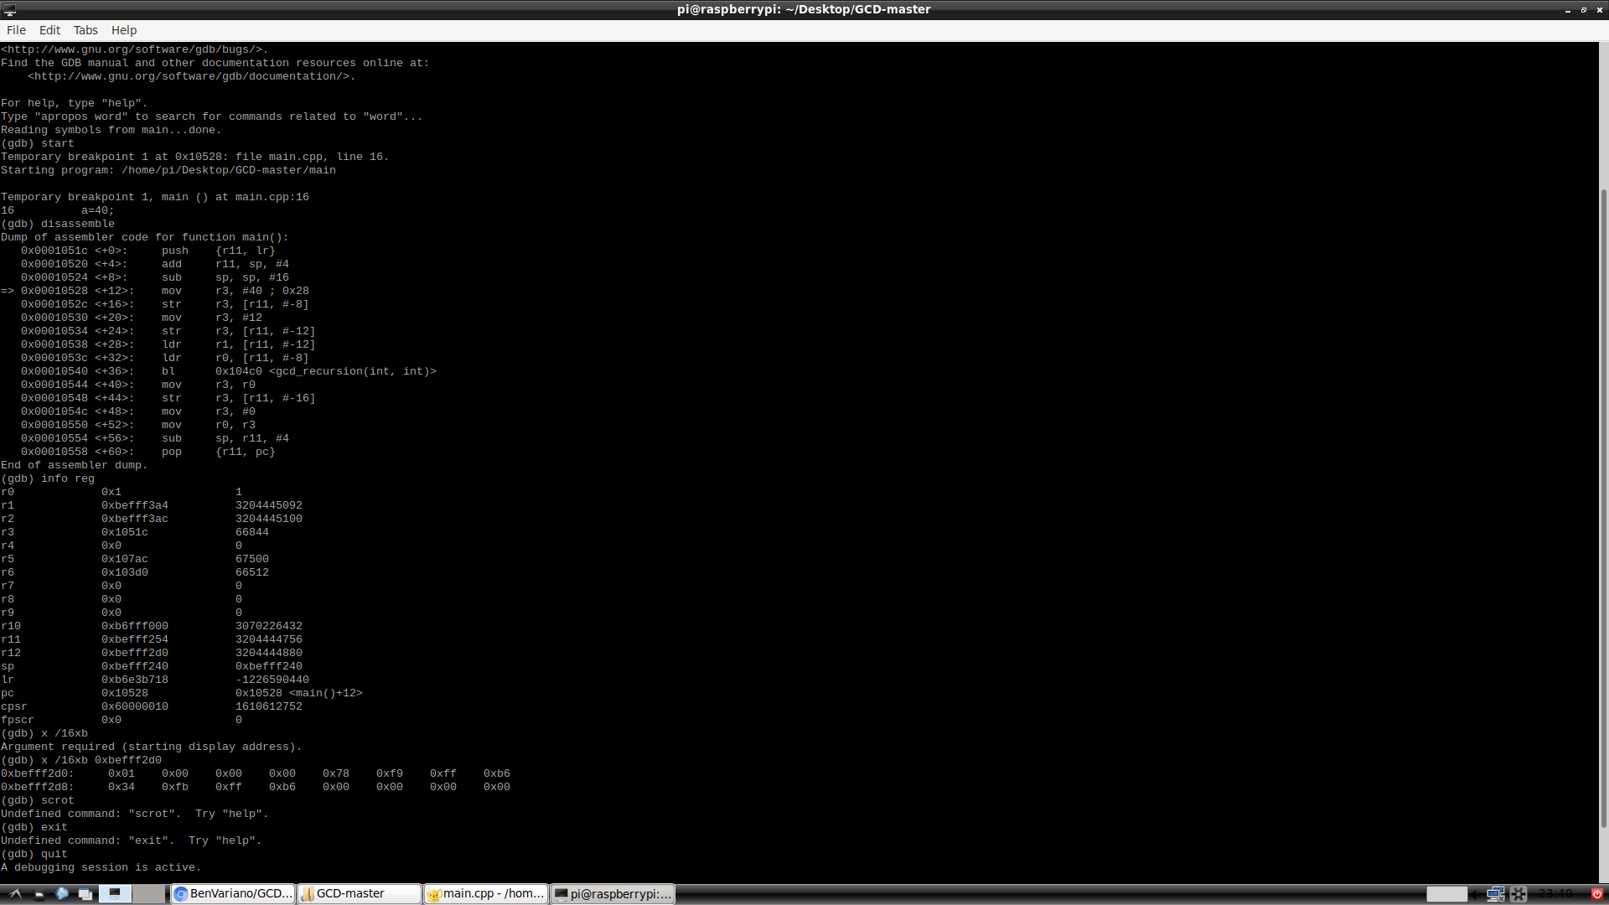
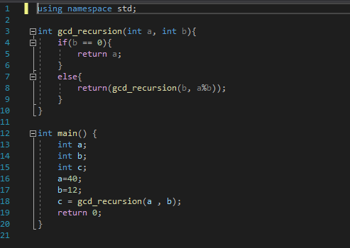
Raspbian
Stack Pointer
Return Address
Instruction pointer

Slide 7
Conclusion
Through our debugging across various platforms, it is clear to see how recursive calls are handled differently depending on the platform which it is being run
The registers vary from platform to platform, varying in name, and sometimes not existing at all (for example no register for return address in Visual studio, it’s on stack)
It is important to note that Raspbian, Linux and Intel will be little endian, while MIPs will follow the big endian convention
Although all have varying structures and rules, all successful platforms for handling computing

Slide 8
Thank You for Listening !

